Slide 1
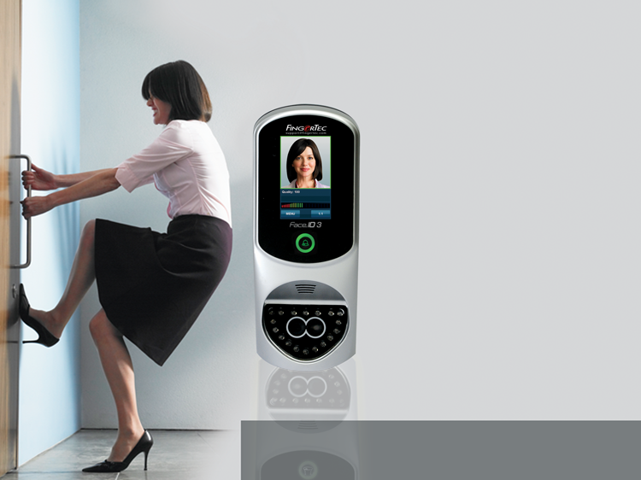

Access Control with Advanced Facial Recognition Technology
The Face ID 3 gives users a
contactless and hassle-free
verification option.
SALES TRAINING|www.fingertec.com

Slide 2
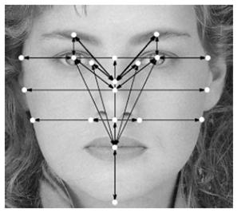
The demand for biometrics is slowly moving toward tighter security, by employing facial recognition for access control.
Copyright © 2012 FingerTec Worldwide Limited. All rights reserved.

Slide 3

Benefits of a Biometric System
Convenient in usage
Accurate data – No “buddy punching”
Contactless (face recognition)
Provides a complete monitoring system
Easy data management
Copyright © 2012 FingerTec Worldwide Limited. All rights reserved.

Slide 4

The Challenge
Many are skeptical and intimidated by the still-novel facial recognition technology, with many questions still in mind.
The misinterpretation that face recognition is too advanced and therefore costly to use in a regular environment.
Copyright © 2012 FingerTec Worldwide Limited. All rights reserved.

Slide 5

The Solution
The Face ID 3 is BOTH cost-efficient AND user-friendly. Plus, enrollment and verification is done in an instant!
Copyright © 2012 FingerTec Worldwide Limited. All rights reserved.

Slide 6

Get Your Value for Money!
The Face ID 3 has all the access control features available in today’s market such as:
Multi Verification
Face, Card, & Password
Speedy Verification
Facial recognition within 2 seconds!
Wiegand Connection
Can connect to third party controllers
Multi- Communication Methods Available
TCP/IP, RS232/RS485, USB Flashdisk
Centralization of Data
TCMS V2 provides easy data management and centralization
Copyright © 2012 FingerTec Worldwide Limited. All rights reserved.

Slide 7

Facial Recognition has never been this advanced!
The Face ID 3 has all the essential requirements of a biometric system
● 400 face templates, 10,000 cards
● 200,000 transaction logs
● Dual camera and infrared face scanning
● Workcode reporting
● Simple enrollment
● Touch screen, user-friendly interface
● Stylish for any environment
Copyright © 2012 FingerTec Worldwide Limited. All rights reserved.

Slide 8



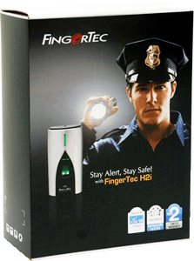
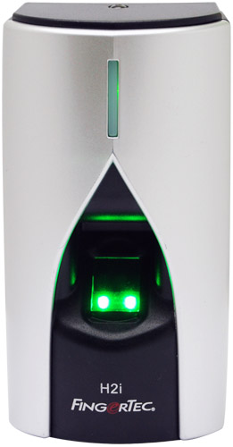
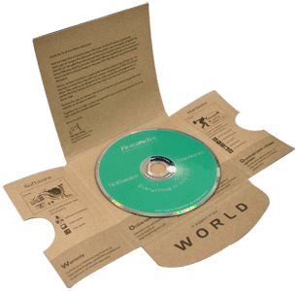
What do you get when you purchase a FingerTec Face ID 3?
Top Quality Hardware
FCC & CE certified
Strictly Monitored Quality Control
Extensive All-in-One CD
TCMS V2 – extensive & user friendly software
Various Language settings
Product manuals & guides
Online Resources
Online manuals & guides
Product Warranty
End-User support website
After sales support
Assistance through various online means (eg: Skype, MSN, email)
Global Product Warranty for up to 24 months
Copyright © 2012 FingerTec Worldwide Limited. All rights reserved.

Slide 9
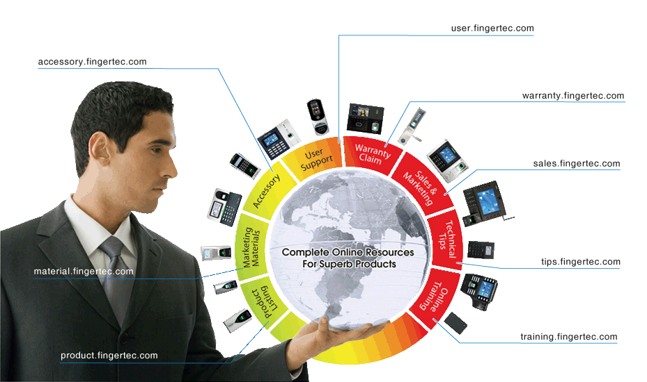
FingerTec Makes Things Easy!
Copyright © 2012 FingerTec Worldwide Limited. All rights reserved.

Slide 10

Installation Made Easy with FingerTec
Site visits are very important in the installation process! Take note of the surrounding features such as:
Type of door
Number of entrances
Type of security level needed
Copyright © 2012 FingerTec Worldwide Limited. All rights reserved.

Slide 11
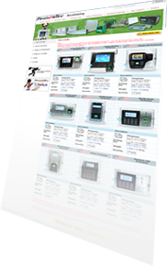
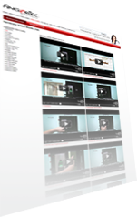

Scout for a good installer to connect door accessories
Prepare door accessories
Measure the position of installation
Installation Process
Inspect wall to avoid damaging other cables during hacking
Connect all cables to terminal
Install TCMS V2 software in PC
Test network connection between terminal and PC
Mount reader on the wall
Test the whole system
Copyright © 2012 FingerTec Worldwide Limited. All rights reserved.

Slide 12


TCMS V2
The Soul of the FingerTec system
Copyright © 2012 FingerTec Worldwide Limited. All rights reserved.

Slide 13

TimeTec
The Web-based Attendance Solution
Copyright © 2012 FingerTec Worldwide Limited. All rights reserved.

Slide 14
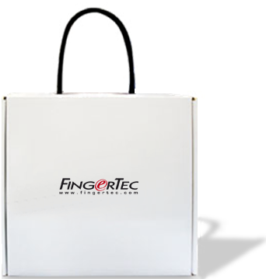

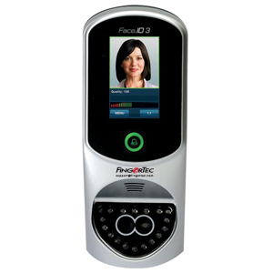
Face ID 3 Demonstration
Watch how FingerTec really makes things easy!
Copyright © 2012 FingerTec Worldwide Limited. All rights reserved.

Slide 15

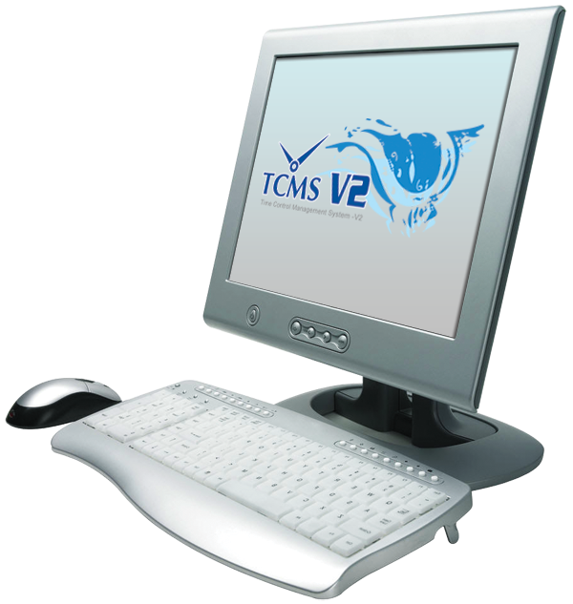
View Attendance & Print Reports
It’s all easy with FingerTec & the TCMS V2!
Copyright © 2012 FingerTec Worldwide Limited. All rights reserved.

Slide 16

Frequently Asked Questions
What kind of verification methods are available with the Face ID 3?
Can the Face ID 3 be integrated with other terminals in a system?
If I wear glasses during enrollment and not verification, will the Face ID 3 still recognize me?
In what format are the face templates stored?
Can the Face ID 3 verify in the dark?
Copyright © 2012 FingerTec Worldwide Limited. All rights reserved.

Slide 17
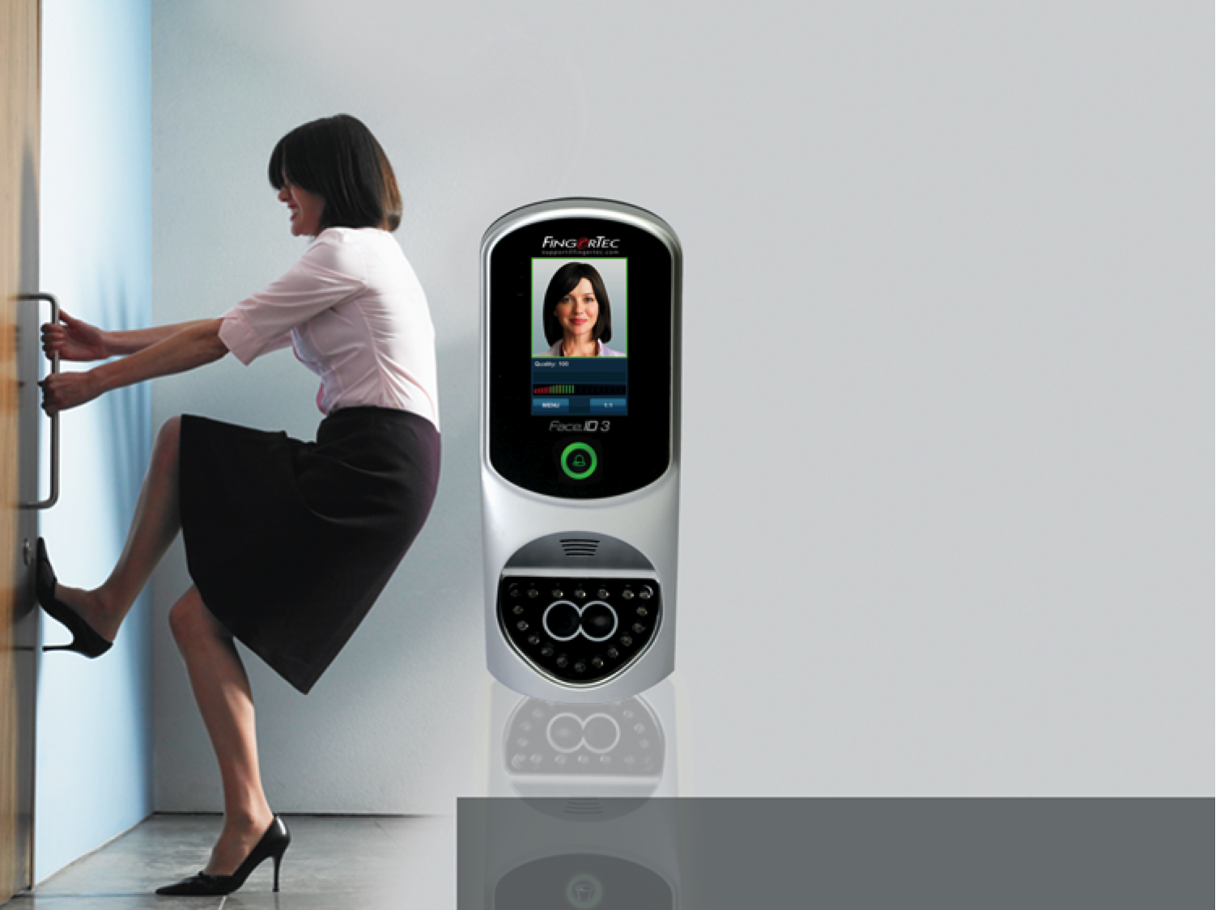

Thank You
Access Control with Advanced Facial Recognition Technology
SALES TRAINING|www.fingertec.com
Copyright © 2012 FingerTec Worldwide Limited. All rights reserved.

